Slide 1
REE-ELECTRODIALYSIS PROCESS MODELLING

Slide 2
Inspiration and Direction
INSPIRATION
Strategy for optimizing in-lab experiments
Cascade separations (multi-pass)
Varying SX formulations
Predict behaviour of more complex systems
DIRECTION
Deterministic model based on the chemical equilibria of chelating agent and ligands in solution
Nernst-Planck equation for electrochemical flux
Model for group separation of REE following Takahashi et al. study
Implementation using scientific libraries in Python

Slide 3

IMPLEMENTATION.
Deterministic model applying numerical methods through an iterative approach.

Slide 4
Process Flow:
Membrane Ion Concentrations:
Assumes equilibrium between CMX membrane and solution
Dependent on ion exchange capacity, Q
Guided User Interface:
Heavy REE Concentration (M)
Light REE Concentration (M)
Chelating agent Concentration (M)
User Input
Ion Exchange Equilibrium
Dissociation Equilibrium
Permeation Equations
Chemical Equilibria:
Purely due to chemical potential
Stability and dissociation constants
System of 6 non-linear equations, 6 unknowns
Nernst-Planck equation:
First order ODE, IVP
Electrochemical flux through the membrane over time

Slide 5

Mathematical Formulations
Dissociation Equilibrium
Ion Exchange Equilibrium
Permeation Equations

Slide 6
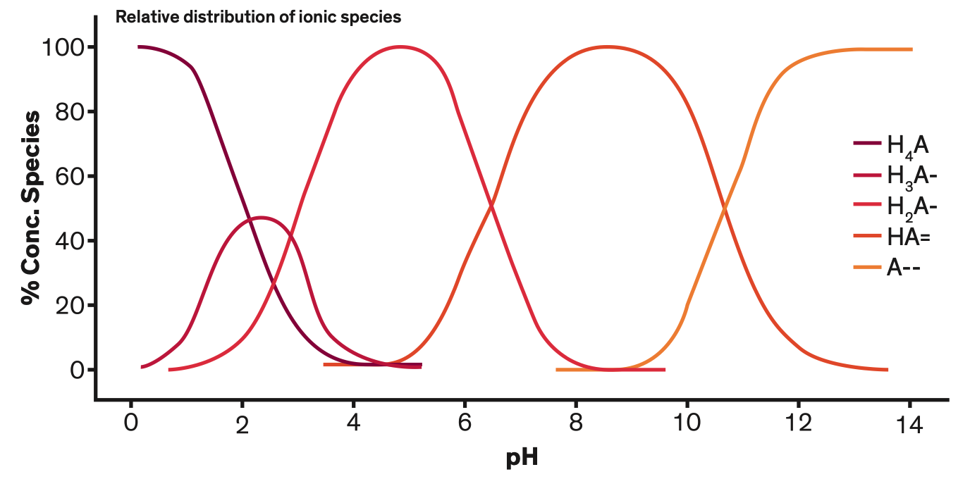

(1) Dissociation Equilibrium
Basic Chemical Equilibria:
$A^{+}+ B^{−} \underset{↔}{K_{ABS}}$ AB
$$K_{ABS}= \frac{[AB]}{\left[A^{+}\right][B^{−}]}$$
Chelation Equilibria:
Chelants will normally form a complex with the metal ligand in a 1:1 ratio
4 dissociation constants for EDTA, and HEDTA, 1 for CDTA
Though usually negligible, at higher concentrations, Na⁺ and other ions in solution that do not directly participate in the chelation reaction lowers the stability constant of metal chelate.^{[1]}

Slide 7

(1) Dissociation Equilibrium
K_{ABS_LREE} [La³⁺][EDTA⁴⁺] – [(EDTA•La)⁻] = 0 | (1) | [EDTA] - [(EDTA•La)⁻] - [(EDTA•Nd)⁻] - [EDTA_{non-complexing}] = 0 | (5)
[La] - [(EDTA•La)⁻] - [La³⁺] = 0 | (2) | [EDTA⁴⁻] – 𝛼₄ [EDTA_{non-complexing}] = 0 | (6)
K_{ABS_HREE} [Nd³⁺][EDTA⁴⁺] – [(EDTA•Nd)⁻] = 0 | (3) | $α_{4}= \prod_{i=1}^{n=4}{k_{n}}$ ÷ ($\prod_{i=1}^{n=4}{k_{n}+\left[H^{+}\right]\prod_{i=1}^{n=3}{k_{n}}+{\left[H^{+}\right]}^{2}\prod_{i=1}^{n=2}{k_{n}}+}$ $${\left[H^{+}\right]}^{3}k_{1}+ {\left[H^{+}\right]}^{4})$$ | (6.1)
[La] - [(EDTA•La)⁻] - [La³⁺] = 0 | (4)
Python functions: fsolve, root
Input: System of 6 non-linear equations
Output: Solutions for REE ion and REE ion•chelating agent complex, Na⁺ concentration, and concentration of non-complexing chelant

Slide 8

(2) Ion Exchange Equilibrium of Membranes
$$\overline{\left[La\right]} − K_{H}^{La}{\overline{\left[H^{+}\right]}}^{3}×{\left(\frac{\left[La^{3+}\right]}{{\left[H^{+}\right]}^{3}}\right)}^{0.8}=0$$ | (1)
$$\overline{\left[Nd\right]} − K_{H}^{Nd}{\overline{\left[H^{+}\right]}}^{3}×{\left(\frac{\left[Nd^{3+}\right]}{{\left[H^{+}\right]}^{3}}\right)}^{0.8}=0$$ | (2)
$$\overline{\left[Na\right]} − K_{H}^{Na}\overline{\left[H^{+}\right]}×(\frac{\left[Na^{+}\right]}{\overline{\left[H^{+}\right]}})=0$$ | (3)
$\overline{Q}−3\sum_{i=1}^{n}{\overline{\left[La^{3+}\right]} }+\overline{\left[Nd^{3+}\right]}$ + $\overline{\left[Na^{+}\right]}$+ $\overline{\left[H^{+}\right]}$ | (4)
Python functions: fsolve, root
Input: System of 4 non-linear equations
Output: Solutions for LREE³⁺, HREE³⁺, Na⁺, and H⁺ concentrations in the membrane
* The bar denotes an ion in the membrane
Notes:
Na+ concentration equals an equivalence term multiplied by the ionized EDTA or chelating agent concentration

Slide 9

(3) Permeation Equations
The Nernst-Planck equation for electrochemical flux is applied for each ion in solution:
$$−V_{F }\frac{d\left[ion\right]}{dt} = S{\overline{J}}_{i}= S\frac{z_{i} D_{i}\overline{\left[ion\right]} I}{\sum_{i=1}^{n+2}{z_{i}^{2} D_{i}\overline{\left[ion\right]}F}}$$
Python functions: solve_ivp, odeint, RK45
Input: LREE³⁺, HREE³⁺, Na⁺, and H⁺ concentrations in the membrane, as well as experiment duration (s), and number of time points (n) to be iterated over
Output: LREE³⁺, HREE³⁺, Na⁺, and H⁺ concentrations to be passed back into system (Section 2)

Slide 10
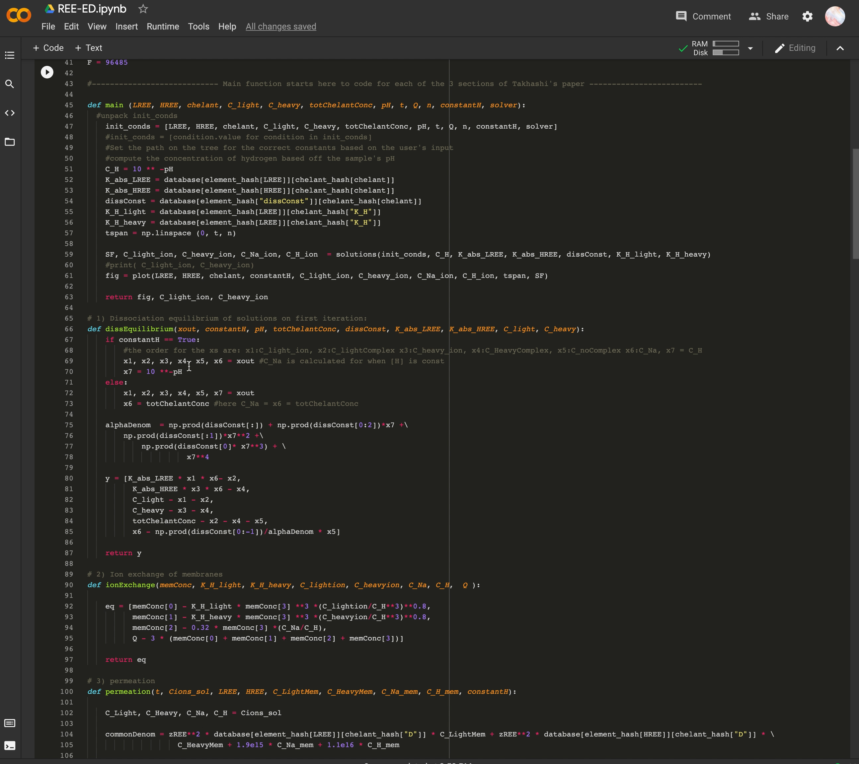
Guided User Interface:
Notes:
So as you can see now, running the model produces a user interface with some widgets.
Here the user can select and change both the type and concentration of elements in solution. From there, the selected values will map back to our database and tell the functions in the model what values to use for the constants. Other parameters such as the ion exchange capacity (Q), duration of experiment, and number of points to be iterated over are also dynamic variables in our model – meaning that they can be selected and changed by the user and simultaneously provide an updated solution.
We can see that by changing the numerical method from runge-kutta-45 to other methods such as LSODA which implements the 8th order adam and backward differentiation formula with automatic stiffness detection and switching, we get approximately the same result for the separation factor.

Slide 11

Evaluating Model Performance
Experimental Results
Deterministic Model
Probabilistic Model (Deep Neural Network)

Slide 12
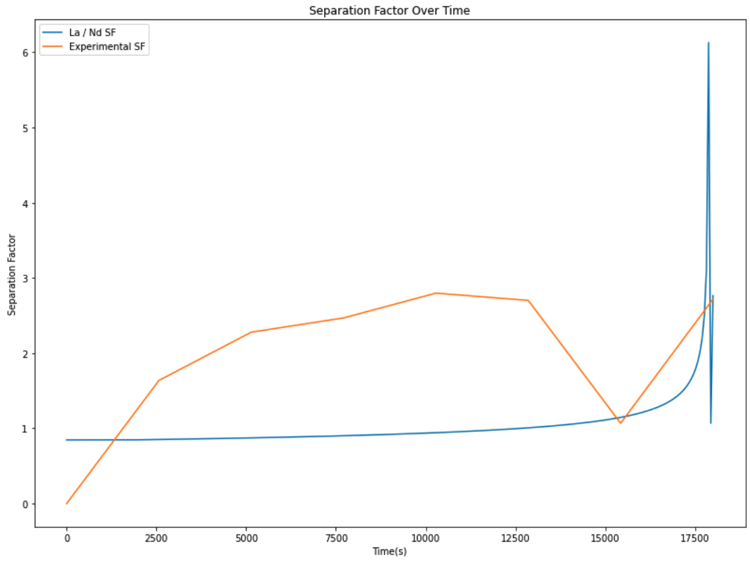
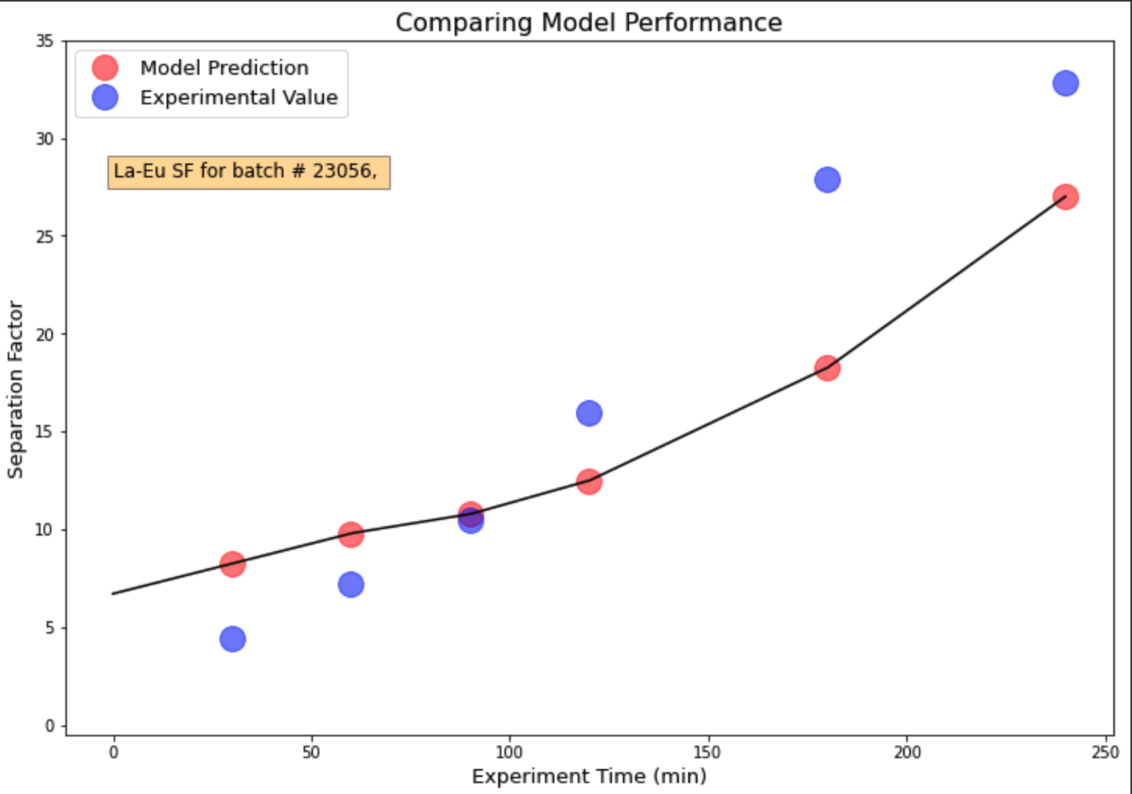
Data Validation:
Takahashi Model:
Batch # 23152: La-Nd separation with EDTA
Machine Learning Model:
La-Eu binary separation with HEDTA
Experimental SF: 2.7174 Computed SF: 2.7646346

Slide 13
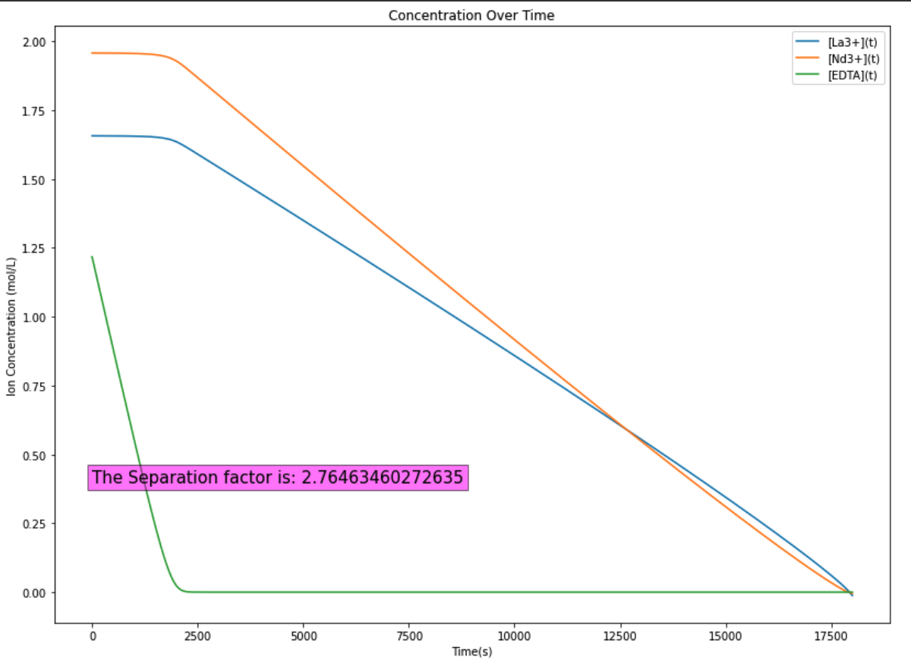
Deterministic Model Trial
Operating Parameters:
LREE: 0.005 M La
HREE: 0.005 M Nd
Chelant: 0.006 M EDTA
pH: 5
Q = 1.48 mEq/g
N = 300
Solver: RK45

Slide 14
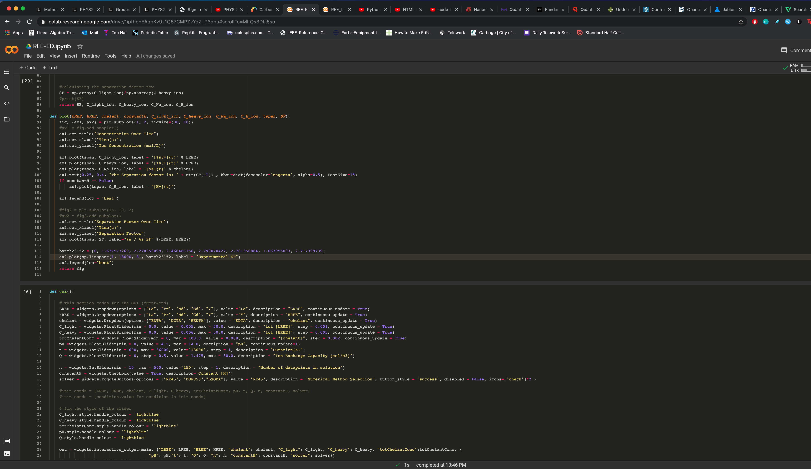
THANKS!
Any Questions?
Deterministic Model: https://colab.research.google.com/drive/1ipfhbnEAqpKv9z1Q57CMPZvYqZ_P3dnu?usp=sharing
Machine Learning Model: https://colab.research.google.com/drive/1Nk2zFW963xWj-BWfKJG3X-sJZ0T1nEkb?usp=sharing

Slide 15
References
[1] https://www.dow.com/content/dam/dcc/documents/en-us/mark-prod-info/113/113-01388-01-chelation-chemistry-general-concepts-of-the-chemistry-of-chelation.pdf?iframe=true

